Slide 1
3.4 Network hardware
Network interface card (NIC)

Slide 2
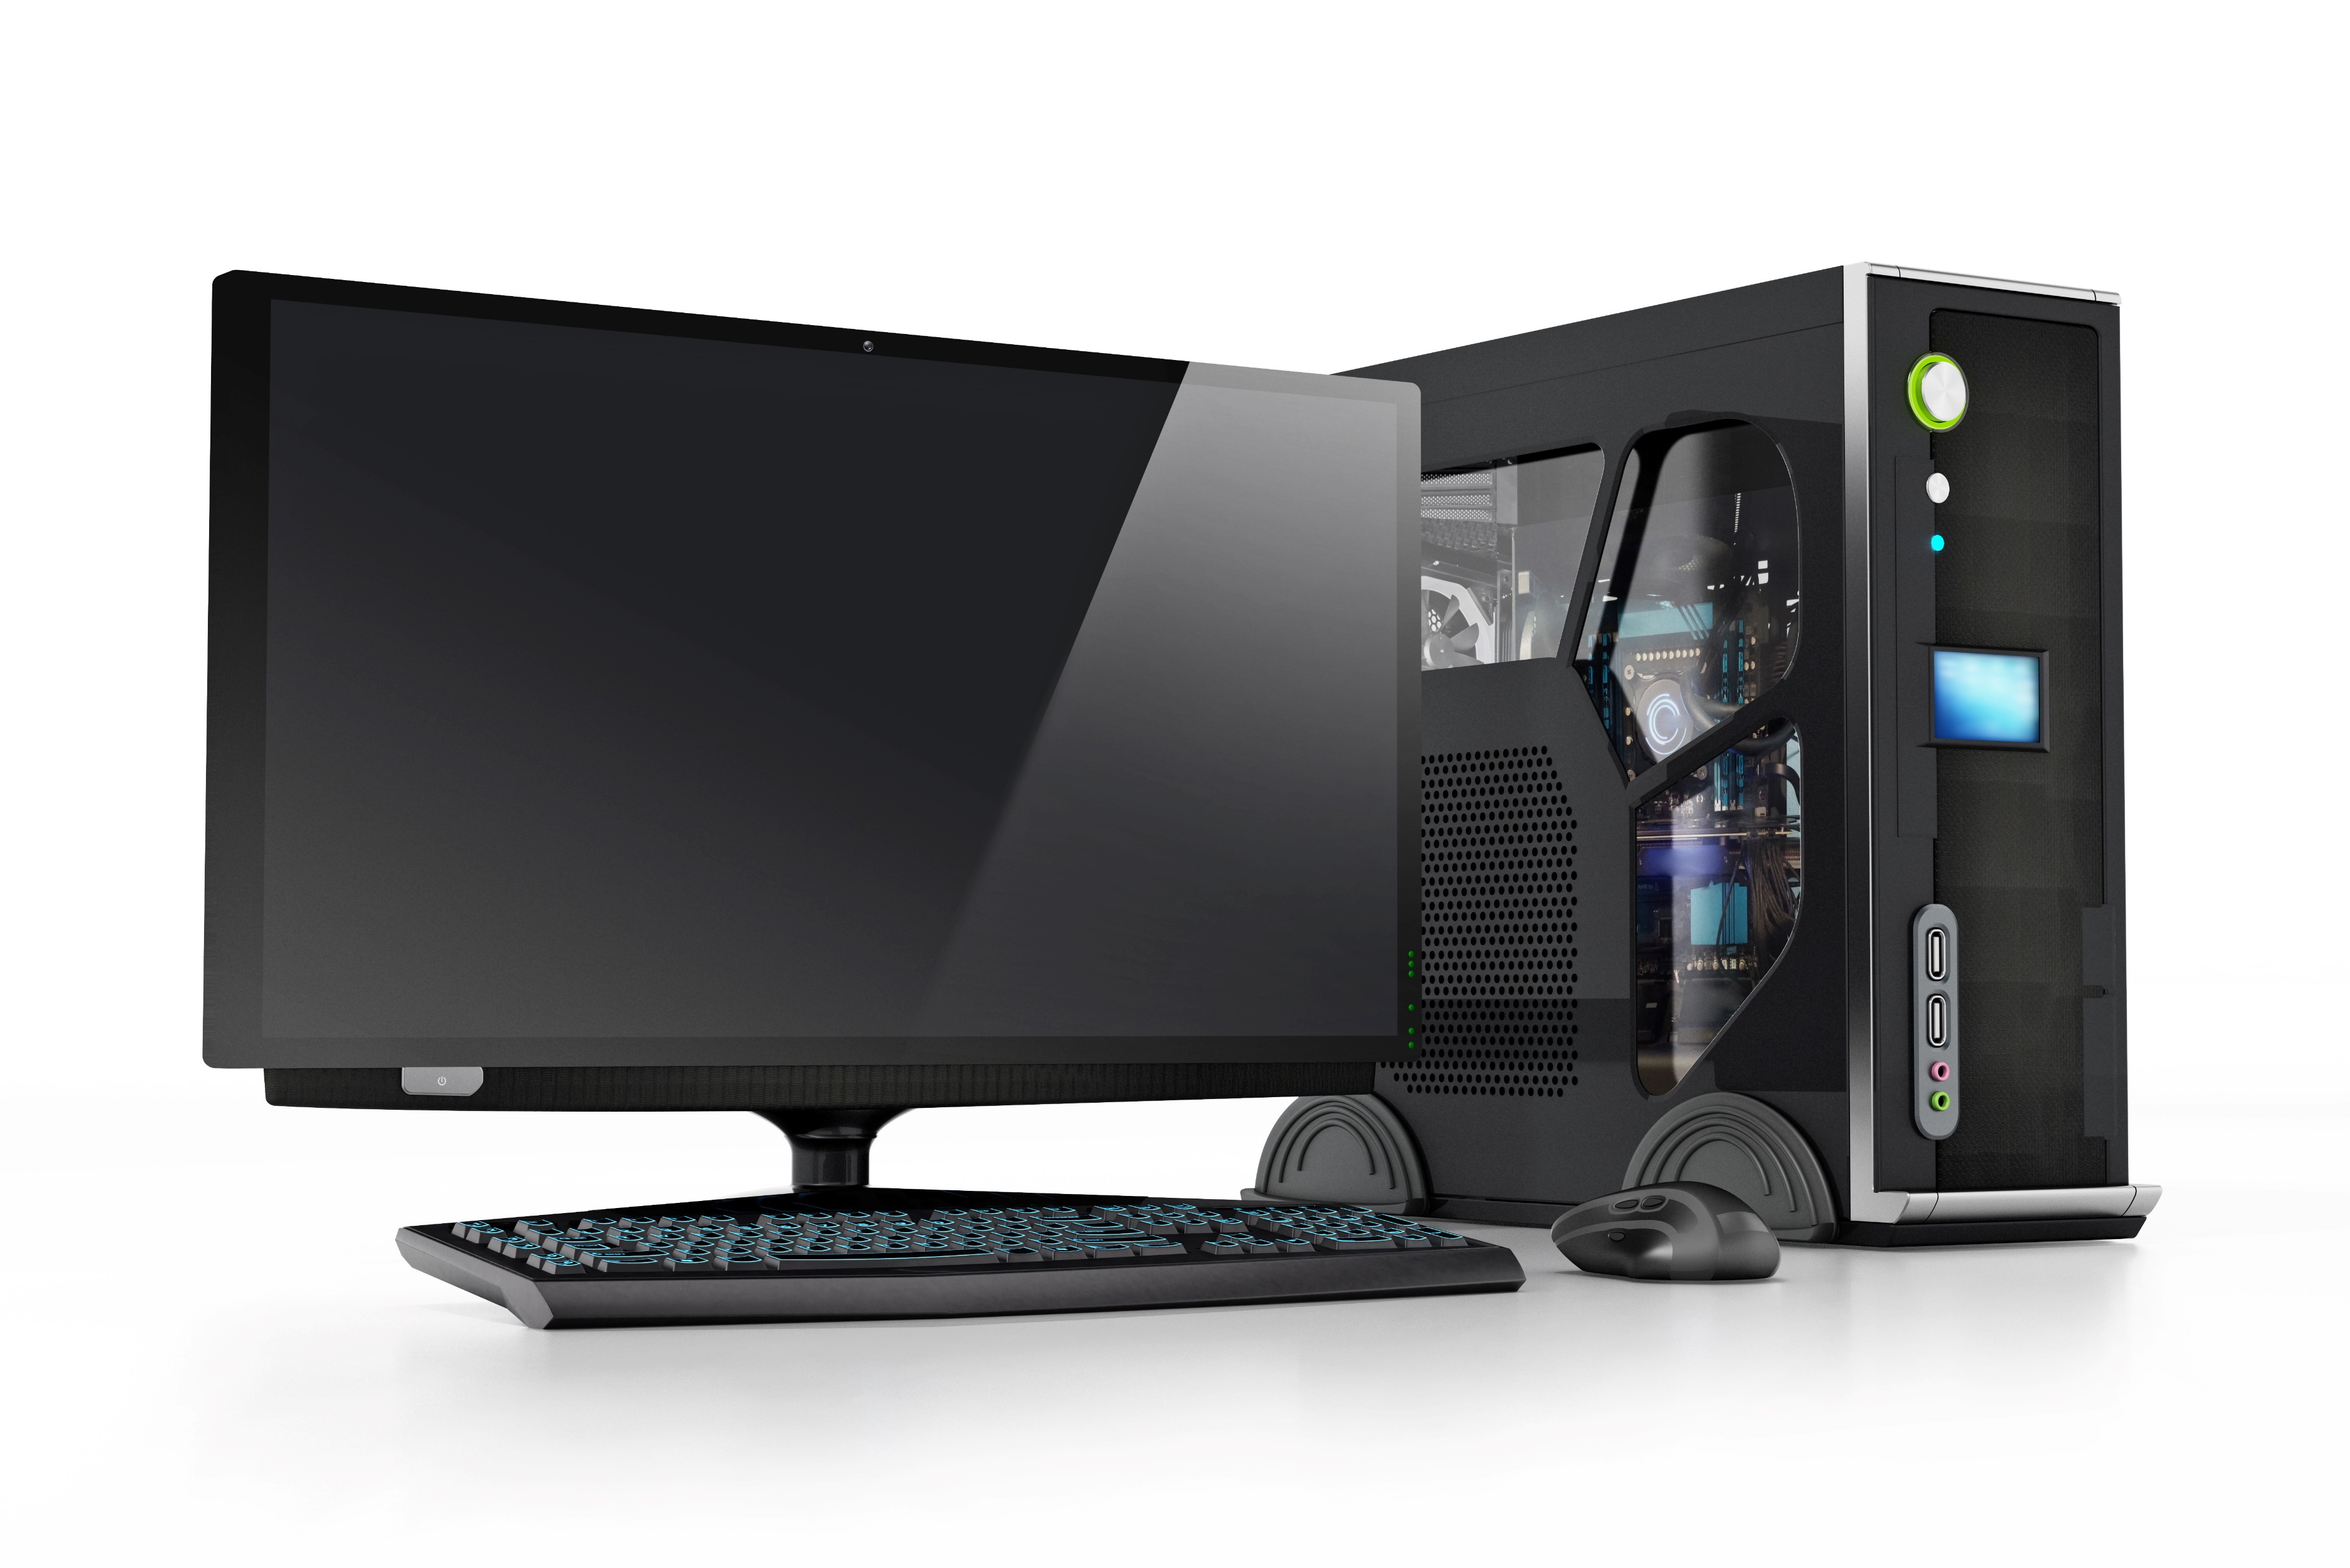
Standalone vs networked
A computing device that is physically unable to communicate with any other device is known as standalone.

Slide 3

Standalone vs networked
As soon as we provide some mechanism for the device to communicate with another device, whether that be via a wired or wireless solution, we can say the device is networked.

Slide 4
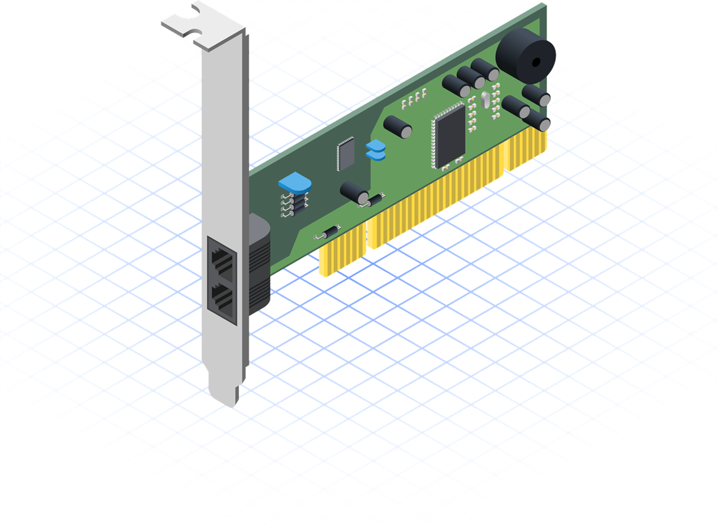
Network interface card (NIC)
Every device connecting to a network needs a network interface card (NIC).
NICs are often also referred to as:
Network interface controller
Network adapter
A NIC uses a set of rules to determine how the connection should work
A NIC allows a device to connect to either a wired or wireless network

Slide 5
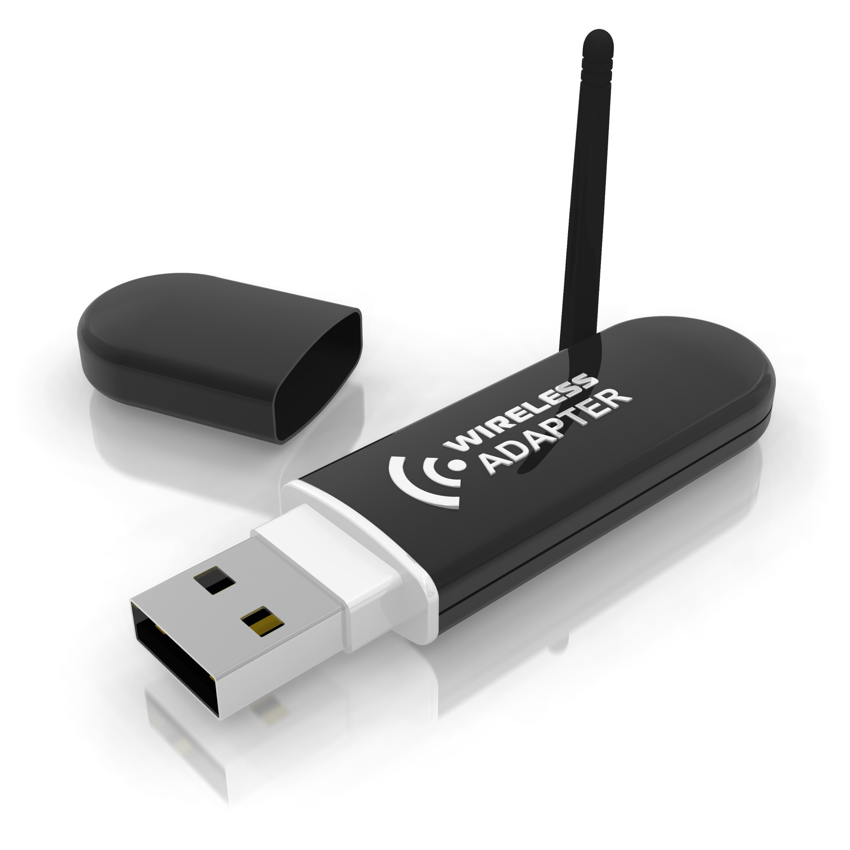
Network interface card (NIC)
Early NICs were commonly implemented as expansion cards plugged into a slot in a computer’s motherboard.
Today, the low cost and universal nature of the Ethernet standard means NICs are now built directly into the motherboard.
Wireless NICs (WNICs) allows a device to connect without cables – they can be:
integrated into the device; or
plugged in – e.g., a USB dongle.

Slide 6
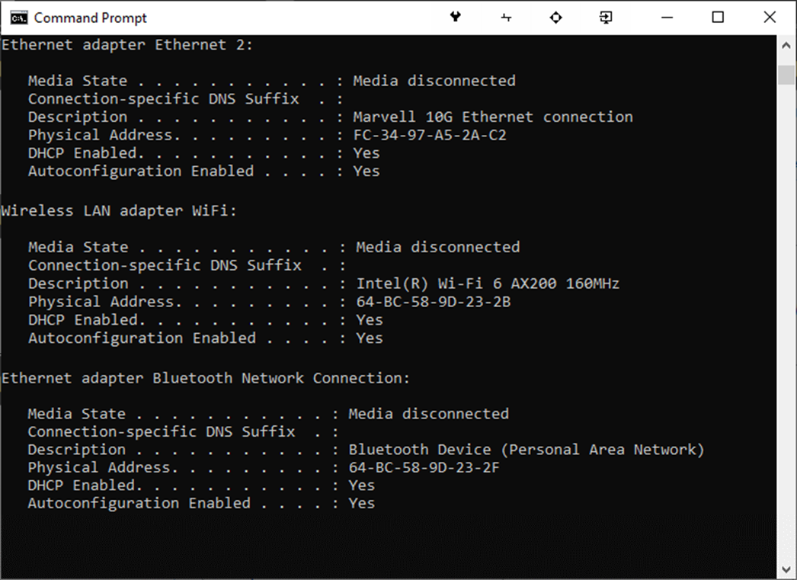
Network interface card (NIC)
A NIC contains a media access control (MAC) address, generated at the manufacturing stage.
It is possible for a device to have multiple separate connections to a network via NICs.
Each connection is assigned its own unique MAC address.

Slide 7

Network interface card (NIC)
A network interface card (NIC) connects a device to a wired or wireless network.
A NIC uses a protocol to ensure successful communication.
A NIC contains a media access control (MAC) address, generated at the manufacturing stage.

Slide 8


